Slide 1
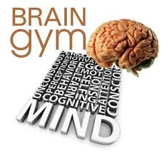
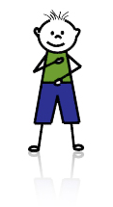
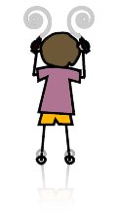
BRAIN BUTTONS
This exercise helps improve blood flow to the brain that helps improve concentration skills required for reading, writing, etc.
POSITIVE POINTS
These points diffuse the “fight or flight” reflex, releasing emotional stress.
Touching these points allows a more rational response to stressful situations.
THE THINKING CAPS
This helps you tune out distracting noises, it increases listening ability, short-term memory and abstract thinking skills.
CROSS OVER MOVEMENT
The slow contralateral movement activates speech and language centers in the brain. Coordination and balance are improved.

